Slide 1
Process Group
Lecture 09A
How to write a job-control shell
process groups and controlling terminals

Slide 2
Materials coming from
Chap. 9, “Process Relationships”
part of the signal concepts from Chap. 10
How to mask a signal
for terminal control

Slide 3
Your Task (Term Project)
a shell capable executing background processes
You can select to write a complete shell program as your term project

Slide 4
Job control that a shell provides

Slide 5
Job control that a shell provides
piped job
$> cat test.txt | enscript –p - | ps2pdf – test.pdf
background job and may submit multiple jobs
$> make all > make.out &
[1] 12345
$> cat test.txt | enscript –p - | ps2pdf – test.pdf &
[2] 12567
$> vim README.txt
switch background job to foreground
$> fg
keep execution after logout
$> nohup make &
$> logout

Slide 6
What is a background job
a set of processes not associated with a controlling terminal
may still display on some terminal
but cannot accept inputs from the keyboard
Examples:
$> xterm &
$> sig10 &
$> fg (switch a background process to foreground)

Slide 7
What you need to know for this Project
session, process group, and controlling terminals associated with a login shell
parallel processes synchronization
at startup
using signals

Slide 8
Login session and process groups
the set of jobs associated with a login shell and a terminal

Slide 9
Process groups in a login session
session
background process group
background process group
foreground process group
login shell
proc 1
proc 2
proc 3
proc 4
proc 5
network disconnect
keyboard inputs and
terminal generated signals (CTRL-C, CTRL-Z)
controlling
terminal

Slide 10
Process groups in a login session
session
session leader, the proc. ID is the session ID
background process group
background process group
foreground process group
login shell
proc 1
proc 2
proc 3
proc 4
proc 5
hang-up signal
network disconnect
keyboard inputs and
terminal generated signals (CTRL-C, CTRL-Z)
controlling
terminal

Slide 11
Process groups in a login session
session
background process group
background process group
foreground process group
login shell
proc 1
proc 2
proc 3
proc 4
proc 5
cat test.txt | enscript –p - &
network disconnect
keyboard inputs and
terminal generated signals (CTRL-C, CTRL-Z)
controlling
terminal

Slide 12
Process groups in a login session
unique foreground job
with connection to controlling terminal
session
background process group
background process group
foreground process group
login shell
proc 1
proc 2
proc 3
proc 4
proc 5
network disconnect
keyboard inputs and
terminal generated signals (CTRL-C, CTRL-Z)
controlling
terminal

Slide 13
Signals coming from terminal driver
login shell
status change
status change
background process group
foreground process group
may generate
SIGTTOU
terminal
input/output
read generates
SIGTTIN
keyboard signals
terminal
driver
user at a
terminal

Slide 14
How to setup process groups
cf. the demo “myshell”

Slide 15
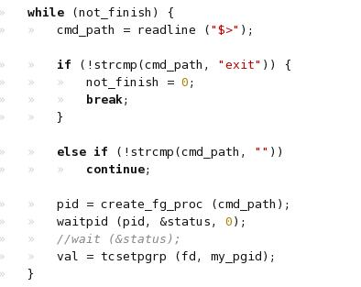
The main-loop of “my_shell”

Slide 16
The main-loop of “my_shell”
read a command line

Slide 17
The main-loop of “my_shell”
the key part of this demo

Slide 18
Setting up a process group (by a shell)
Step 1: fork new processes
Step 2: assign a new process group
Step 3: (for fore-ground job) switching the control terminal
Step 4: wait for a process group terminated
and get back the control terminal

Slide 19
Setting up a process group (by a shell)
Step 1: fork new processes
Step 2: assign a new process group
Step 3: (for fore-ground job) switching the control terminal
Step 4: wait for a process group terminated
and get back the control terminal

Slide 20
Process groups in a login session
session
background process group
background process group
foreground process group
login shell
proc 1
proc 2
proc 3
proc 4
proc 5
setup a session:
pid_t setsid (void);
to know which session I am in:
pid_t getsid (pid_t pid);
network disconnect
keyboard inputs and
terminal generated signals (CTRL-C, CTRL-Z)
controlling
terminal

Slide 21
Setting up a process group
session
getpgid (pid)
background process group
background process group
foreground process group
login shell
proc 1
proc 2
proc 3
proc 4
setpgid (pid, pgid)
proc 5
Limitation:
a process can only set the pgid of itself or it’s child
pgid cannot be changed after exec() executed
network disconnect
keyboard inputs and
terminal generated signals (CTRL-C, CTRL-Z)
controlling
terminal

Slide 22
Q: How to do startup synchronization?
parent
child
fork ()
exec ()
time
setpgid (…)
execute too late

Slide 23
How to do startup synchronization
parent
child
stop immediately after fork
fork ()
a signal to enable child execution
pause ()
setpgid (…)
wait for signal
time
kill (…)
exec ()

Slide 24
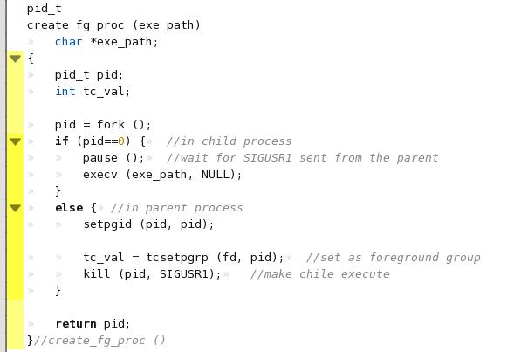
Demo: my_shell
to create a fore-ground process

Slide 25
Demo: my_shell
to create a fore-ground process
assign a new process group
(by setting the child process as the group leader)

Slide 26
Demo: my_shell
to create a fore-ground process
the child process halt here
(to wait for the parent finishes its settings)
send a signal to make child running after everything is done

Slide 27
Setting up a process group (by a shell)
Step 1: fork new processes
Step 2: assign a new process group
Step 3: (for foreground job) switching the control terminal
Step 4: wait for a process group terminated
and get back the control terminal

Slide 28
Transfer controlling terminal
session
got from filedes = open (“/dev/tty”, …)
background process group
background process group
foreground process group
login shell
proc 1
proc 2
proc 3
proc 4
proc 5
tcsetpgrp (filedes, pgid)
network disconnect
keyboard inputs and
terminal generated signals (CTRL-C, CTRL-Z)
controlling
terminal

Slide 29
Remark
to know who has the controlling terminal:
tcgetpgrp (filedes);

Slide 30
Demo: my_shell
to create a fore-ground process
transfer the control terminal to the child process

Slide 31
Setting up a process group (by a shell)
Step 1: fork new processes
Step 2: assign a new process group
Step 3: (for fore-ground job) switching the control terminal
Step 4: wait for a process group terminated
and get back the control terminal

Slide 32
Limitation
session
can only be executed by who owns the controlling terminal
background process group
background process group
foreground process group
login shell
proc 1
proc 2
proc 3
proc 4
proc 5
tcsetpgrp (filedes, pgid)
network disconnect
keyboard inputs and
terminal generated signals (CTRL-C, CTRL-Z)
controlling
terminal

Slide 33
Q: How to get back the controlling terminal
session
got SIGTTOU and stopped when turning back
background process group
background process group
foreground process group
login shell
proc 1
proc 2
proc 3
proc 4
proc 5
SIGTTOU
tcsetpgrp (filedes, pgid)
network disconnect
keyboard inputs and
terminal generated signals (CTRL-C, CTRL-Z)
controlling
terminal

Slide 34
Q: How to get back the controlling terminal
session
The Solution: block the signal!
background process group
background process group
foreground process group
login shell
proc 1
proc 2
proc 3
proc 4
proc 5
SIGTTOU
tcsetpgrp (filedes, pgid)
network disconnect
keyboard inputs and
terminal generated signals (CTRL-C, CTRL-Z)
controlling
terminal

Slide 35
How to block a signal
materials from Chap. 10

Slide 36
The system call
int sigprocmask (int how, sigset_t *set, sigset_t *oldset);
old bit mask
the bit mask to block signals
SIG_BLOCK
SIG_UNBLOCK
SIG_SETMASK

Slide 37
How to prepare the bitmask
int sigemptyset (sigset_t *set)
int sigfillset (sigset_t *set)
int sigaddset (sigset_t *set, int signo)
int sigdelset (sigset_t *set, int signo)

Slide 38

The Code

Slide 39
Demo: my_shell
the main-loop to accept commands

Slide 40
Demo: my_shell
the main-loop to accept commands
get back the control terminal after child process terminated

Slide 41
The shell project
A choice for your term project

Slide 42
Spec of the project
a shell has the following functions:
executing a foreground process
$> ./a.out
executing a background process
$>./a.out &
switch a background process to foreground
$> fg
Remark: the complete job-control shell is left as your term project (if you want)

Slide 43
How a login shell started
Appendix

Slide 44
Starting a login-shell at console
init
(pid 1)
fork
init
to startup the terminal driver
for console
exec
mgetty
exec
login
fork+exec
shell
(e.g. /bin/bash)

Slide 45
Starting a remote login shell
init
see /etc/rc
TCP connection
from Internet
xinetd
fork+exec
telnetd/
sshd
allocate a pseudo terminal
fork+exec
shell
(/bin/bash)

Slide 46
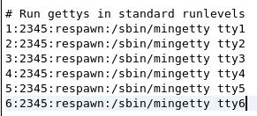
Scripts to start login terminal
/etc/inittab

Slide 47
Appendix
some other implementation details

Slide 48
Data structure to organize all process groups
use linked list to organize the dynamically changing process groups
learn how to use malloc() and free()
proc. 1
proc. 2
proc. group 1
1024
1025
proc. group 2
1037
1039
1040
proc. group 3
1046

Slide 49
How to know the status of a child?
please man the two system calls
wait
waitpid
for waiting background process, use wait/waitpid as non-blocking

Slide 50
How to read a line?
Please man
readline

